Slide 1
Default of credit card clients
Deepika Srinivasan
Notes:
A cover page with the project title and group member names
Contribution to the project by each group member
An introduction of your project
4. Result of decision tree using holdout method
5. Result of decision tree using bagging
6. Result of decision tree using random forest
7. Result of Naïve Bayes classifier
8. Result of support vector machine using liner kernel with different costs
9. Result of support vector machine using radial kernel with different costs and gammas
10. Result of support vector machine using polynomial kernels with different costs and gammas
11. Comparison of multiple classification techniques
12. Potential performance issues and possible future study
13. Conclusion of your project
14. An appendix of your R source codes

Slide 2
Dataset- Introduction
What?
Predict Default Payment
Who?
Taiwan Customers
How?
Background information and Payment history of 30000 customers

Slide 3
Attributes-Bird’s eye view
Default Payment
Demographic Data
Credit Data
Payment History
Bill Statements
& Bill Amounts
Notes:
demographic factors, credit data, history of payment, and bill statements of credit card customers from April 2005 to September 2005, as well as information on the outcome: did the customer default or not?

Slide 4
Attributes – Closer look
Demographic Factors
Gender (1 = male; 2 = female)
Education (1 = graduate school; 2 = university; 3 = high school; 4 = others)
Payment History
(April -Sep, 2005)
6 columns ,1 for each month
Values:-1 = pay duly; 1 = payment delay for one month; 2 = payment delay for two months; . . .; 8 = payment delay for eight months; 9 = payment delay for nine months and above.
Bill Statements
(April-Sep,2005)
6 columns ,1 for each month
Misc-ID,Limit Balance
Marital Status(1 = married; 2 = single; 3 = others)
Age
Notes:
Limit –Balance :Amount of the given credit (NT dollar): it includes both the individual consumer credit and his/her family (supplementary) credit.

Slide 5
HIGHlights about dataset
Female > Male , Non-default>Default
Defaulters : Less Credit Limit
Non-defaulters : Highly educated
Marital Status : 79.09% Single and 76.53 %Married will not default
Number of customers with Payment delay >2 months is less
Notes:
Number of Female customers are more
Defaulters have less credit limt
Non-defaulters: University and Grad level higher proportion
Number of customers with Payment delay >= 2 months is lesser
79.09% Single and 76.53% Married – will not default

Slide 6
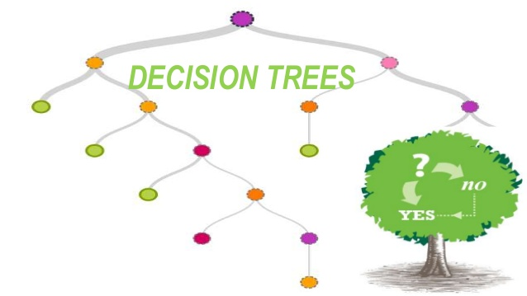
Hold-out method Bagging Random forest

Slide 7
Holdout
Hold-out some of the rows of the dataset for testing (10000 rows) and rest for training model(20000).
Predictive model is built using only the training set
Test set is now used to compare the predicted Vs Actual results
Notes:
Hold-out some of rows of the dataset for testing; use the other half for training 2. Build a predictive model using ONLY the training set 3. Use the test set to compare predicted answers and actual answers

Slide 8

Holdout
Training Error 0.1801
Test Error 0.181

Slide 9
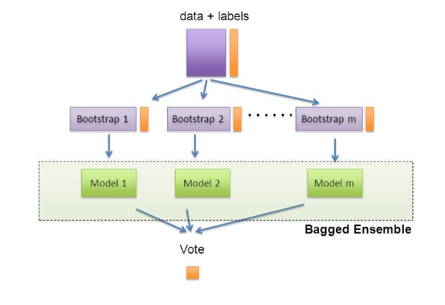
bagging

Slide 10
Bagging results
Default mtry
500 trees
0.179
Default mtry
1500 trees
0.1786
24 mtry
1500 trees
0.1835
24 mtry
500 trees
0.1825

Slide 11
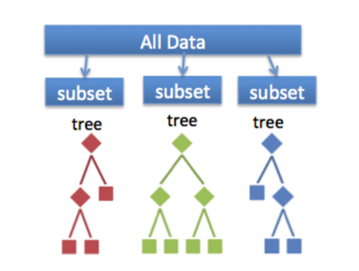
random forest
Notes:
Random forest takes a random number of features from the data, and creates n random trees from each subset.Trees are aggregated together at the end

Slide 12
RANdomforest results
Mtry=4
Mtry=5
0.1809
Mtry=6
0.1813
0.1792

Slide 13
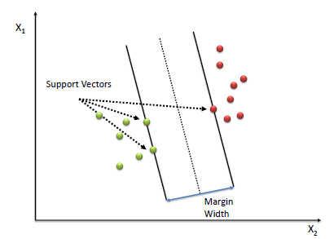

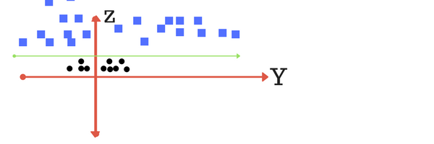
Support vector- linear
COST | TRAIN ERROR | TEST ERROR
0.001 | 0.215 | 0.2118
0.01 | 0.19045 | 0.1907
0.1 | 0.1904 | 0.1907
1(default) | 0.1898 | 0.1903

Slide 14
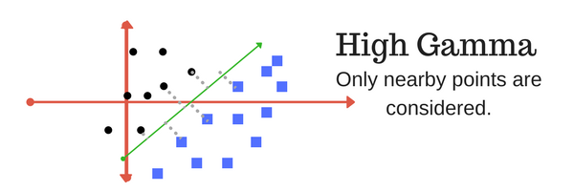
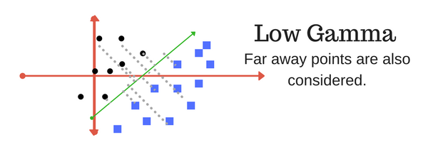
Support vector – Radial
COST | GAMMA | TRAIN ERROR | TEST ERROR | SUPPORT VECTORS
0.1 | 0.01 | 0.18965 | 0.19 | 8643
 | Default (0.0417) | 0.18195 | 0.1852 | 8903
 | 0.07 | 0.1809 | 0.1844 | 9352
 | 0.1 | 0.18175 | 0.185 | 9982
 | 1 | 0.2234 | 0.2168 | 16878
 | 3 | 0.2234 | 0.2168 | 19089

Slide 15
Support vector – Radial
COST | GAMMA | TRAIN ERROR | TEST ERROR
1 | 0.01 | 0.1807 | 0.1821
 | Default (0.0417) | 0.1729 | 0.1812
 | 0.07 | 0.16755 | 0.1827
 | 0.1 | 0.16235 | 0.1823
 | 1 | 0.06305 | 0.2073
 | 3 | 0.02925 | 0.2184
COST | GAMMA | TRAIN ERROR | TEST ERROR
10 | 0.01 | 0.1754 | 0.1798
 | Default (0.0417) | 0.15575 | 0.1835
 | 0.07 | 0.13315 | 0.1885
 | 0.1 | 0.1131 | 0.1939
 | 1 | 0.0131 | 0.2332
 | 3 | 0.00165 | 0.2319

Slide 16
Support vector - polynomial
COST | DEGREE | TRAIN ERROR | TEST ERROR
10 | 2 | 0.20655 | 0.2079
 | 3(default) | 0.1682 | 0.1932
 | 4 | 0.15375 | 0.2015
COST | DEGREE | TRAIN ERROR | TEST ERROR
1 | 2 | 0.213 | 0.2138
 | 3(default) | 0.18395 | 0.1923
 | 4 | 0.1818 | 0.1995

Slide 17
Support vector - polynomial
COST | DEGREE | TRAIN ERROR | TEST ERROR
0.1 | 2 | 0.2203 | 0.216
 | 3(default) | 0.19865 | 0.2013
 | 4 | 0.20275 | 0.2065
 | 5 | 0.19585 | 0.2065
COST | DEGREE | GAMMA | TRAIN ERROR | TEST ERROR
0.1 | 3(default) | default | 0.19865 | 0.2013
 |  | 0.07 | 0.18925 | 0.194
 |  | 0.1 | 0.18135 | 0.1927

Slide 18
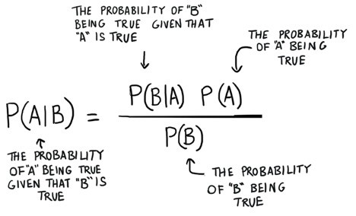
Naïve bayes classifier
Computationally fast
Works well with high dimensions
Simple to implement
Can be easily trained using a small data set
Train Error
0.3528
Test Error
0.3508

Slide 19
Comparison - Decision Tree Techniques

Slide 20
Comparison - Support Vector Machines Techniques

Slide 21
Comparison of multiple classification techniques

Slide 22
Potential performance issues and possible future study
Performance Issues:
Slow processing- SVM Linear
Larger dataset
Increased number of support vectors
Intensity of the algorithm
Possible Future Study:
Emphasis on Data Quality
Data profiling & assessment
Data cleansing & standardization
Test with other different data mining techniques
Benchmark their performances

Slide 23


Conclusion
Best classification technique:
Bagging
Possible reasons:
Reduces variance and prevents overfitting
Easily handles qualitative (categorical) features
Poor classification technique:
Naïve Bayes
Possible reasons:
Relies on independence assumption and performs poorly if this assumption is not met
Naive Bayes best suits for text classification

Slide 24
Thank you

